Slide 1
W3C Web of Things + Oracle IoT Asset Monitoring
Michael Lagally
30.1.2019

Slide 2
W3C Web of Things
The Web of Things standard allows to describe devices (things) in a common ways across device manufacturers and protocols.
It is developed in the W3C working group with participants from Siemens, Intel, Panasonic, Hitachi, Fujitsu and SmartThings and others.
Oracle focuses on interoperability and mashup scenarios of Oracle‘s IoT Cloud Service and Applications with devices from WoT participants.

Slide 3
Oracle IoT Applications
Apps
Platform
Asset
Monitoring
Production
Monitoring
Fleet
Monitoring
Connected
Worker
IOT Cloud Service
Digital Twin
Simulator

Slide 4
Oracle Device Model and W3C Thing Description Interworking
Client
App
Sim1
Common
Device Model
Sim2
Oracle IOT
Cloud Service
Web of Things

Slide 5
Oracle Device Model and W3C Thing Description Interworking
Client
App
Sim1
Sim2
TD
Sim1
TD
DM2TD converter
Common
Device Model
Sim2
Oracle IOT
Cloud Service
Web of Things

Slide 6
Oracle Device Model and W3C Thing Description Interworking
Client
App
Sim1
Sim2
TD
Sim1
TD
DM2TD converter
Common
Device Model
Sim2
WoT
Device
(Expose)
WoT Dev
Simulator
WoT Dev
TD
Oracle IOT
Cloud Service
Web of Things

Slide 7
Oracle Device Model and W3C Thing Description Interworking
Client
App
Sim1
Sim2
TD
Sim1
TD
DM2TD converter
Common
Device Model
Sim2
WoT
Device
(Expose)
WoT Dev
Simulator
WoT Dev
Device Model
WoT Dev
TD
TD2DM converter
Oracle IOT
Cloud Service
Web of Things

Slide 8
Oracle Device Model and W3C Thing Description Interworking
Client
App
Sim1
Sim2
TD
Sim1
TD
DM2TD converter
Common
Device Model
WoT Dev Sim
TD
Sim2
WoT
Device
(Expose)
WoT Dev
Simulator
WoT Dev
Device Model
WoT Dev
TD
TD2DM converter
WoT Dev
Digital Twin
Oracle IOT
Cloud Service
Web of Things

Slide 9
Oracle Device Model and W3C Thing Description Interworking
Client
App
Sim1
Sim2
TD
Sim1
TD
DM2TD converter
Common
Device Model
WoT Dev Sim
TD
WoT Dev Twin
TD
Sim2
WoT
Device
(Expose)
WoT Dev
Simulator
WoT Dev
Device Model
WoT Dev
TD
TD2DM converter
WoT Dev
Digital Twin
Oracle IOT
Cloud Service
Web of Things

Slide 10
Oracle Device Model and W3C Thing Description Interworking
Client
App
Sim1
Sim2
TD
Sim1
TD
DM2TD converter
Common
Device Model
WoT Dev Sim
TD
WoT Dev Twin
TD
Sim2
NodeWoT
Bridge/Gateway
WoT
Device
(Expose)
WoT Dev
Simulator
WoT Dev
Device Model
WoT Dev
TD
TD2DM converter
WoT Dev
Digital Twin
Oracle IOT
Cloud Service
Web of Things

Slide 11
Asset Monitoring of plugfest devices
WoT members use various different devices during the plug fests
Device models were generated using the td2dm converter
they were imported into the Oracle IoT Cloud service
Simulators were created for these devices
Thing descriptions for these Simulators were generated using the dm2td converter

Slide 12
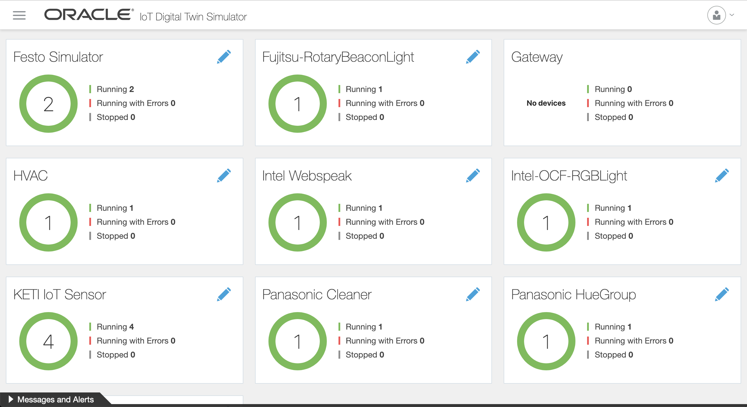
Digital Twin Simulators

Slide 13
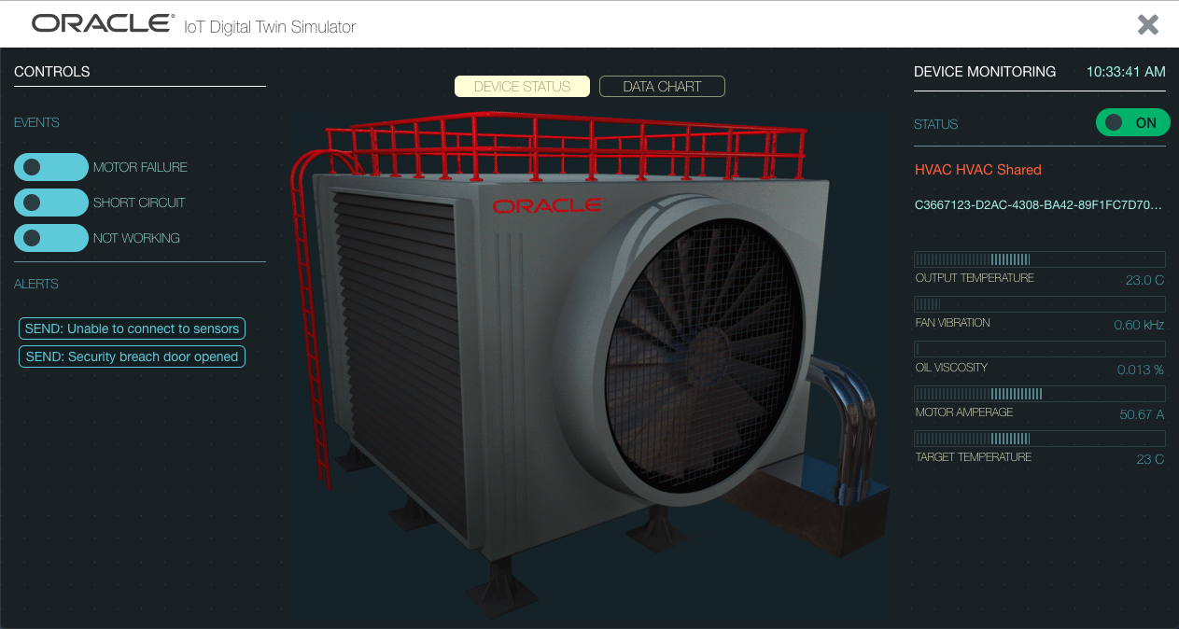
HVAC Simulator

Slide 14
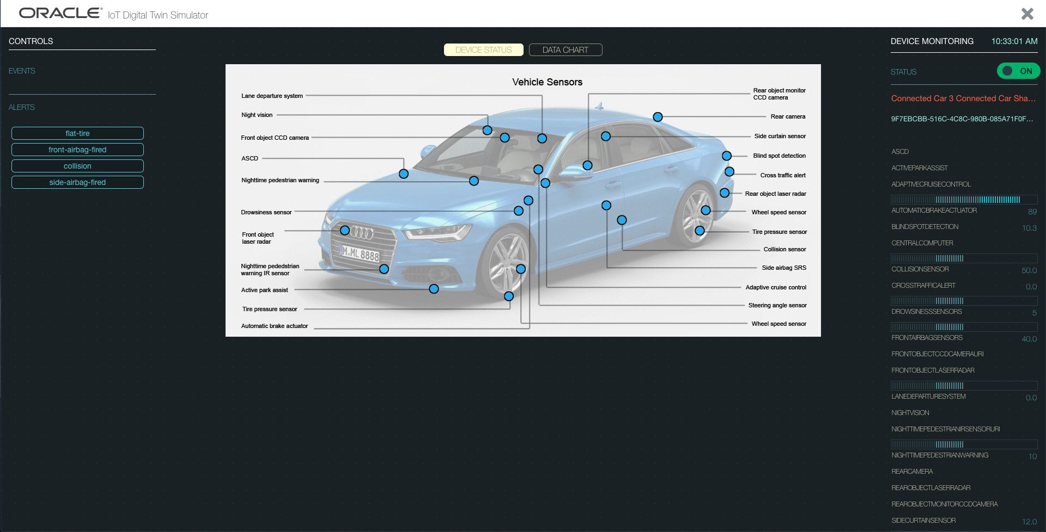
Connected Car Simulator

Slide 15
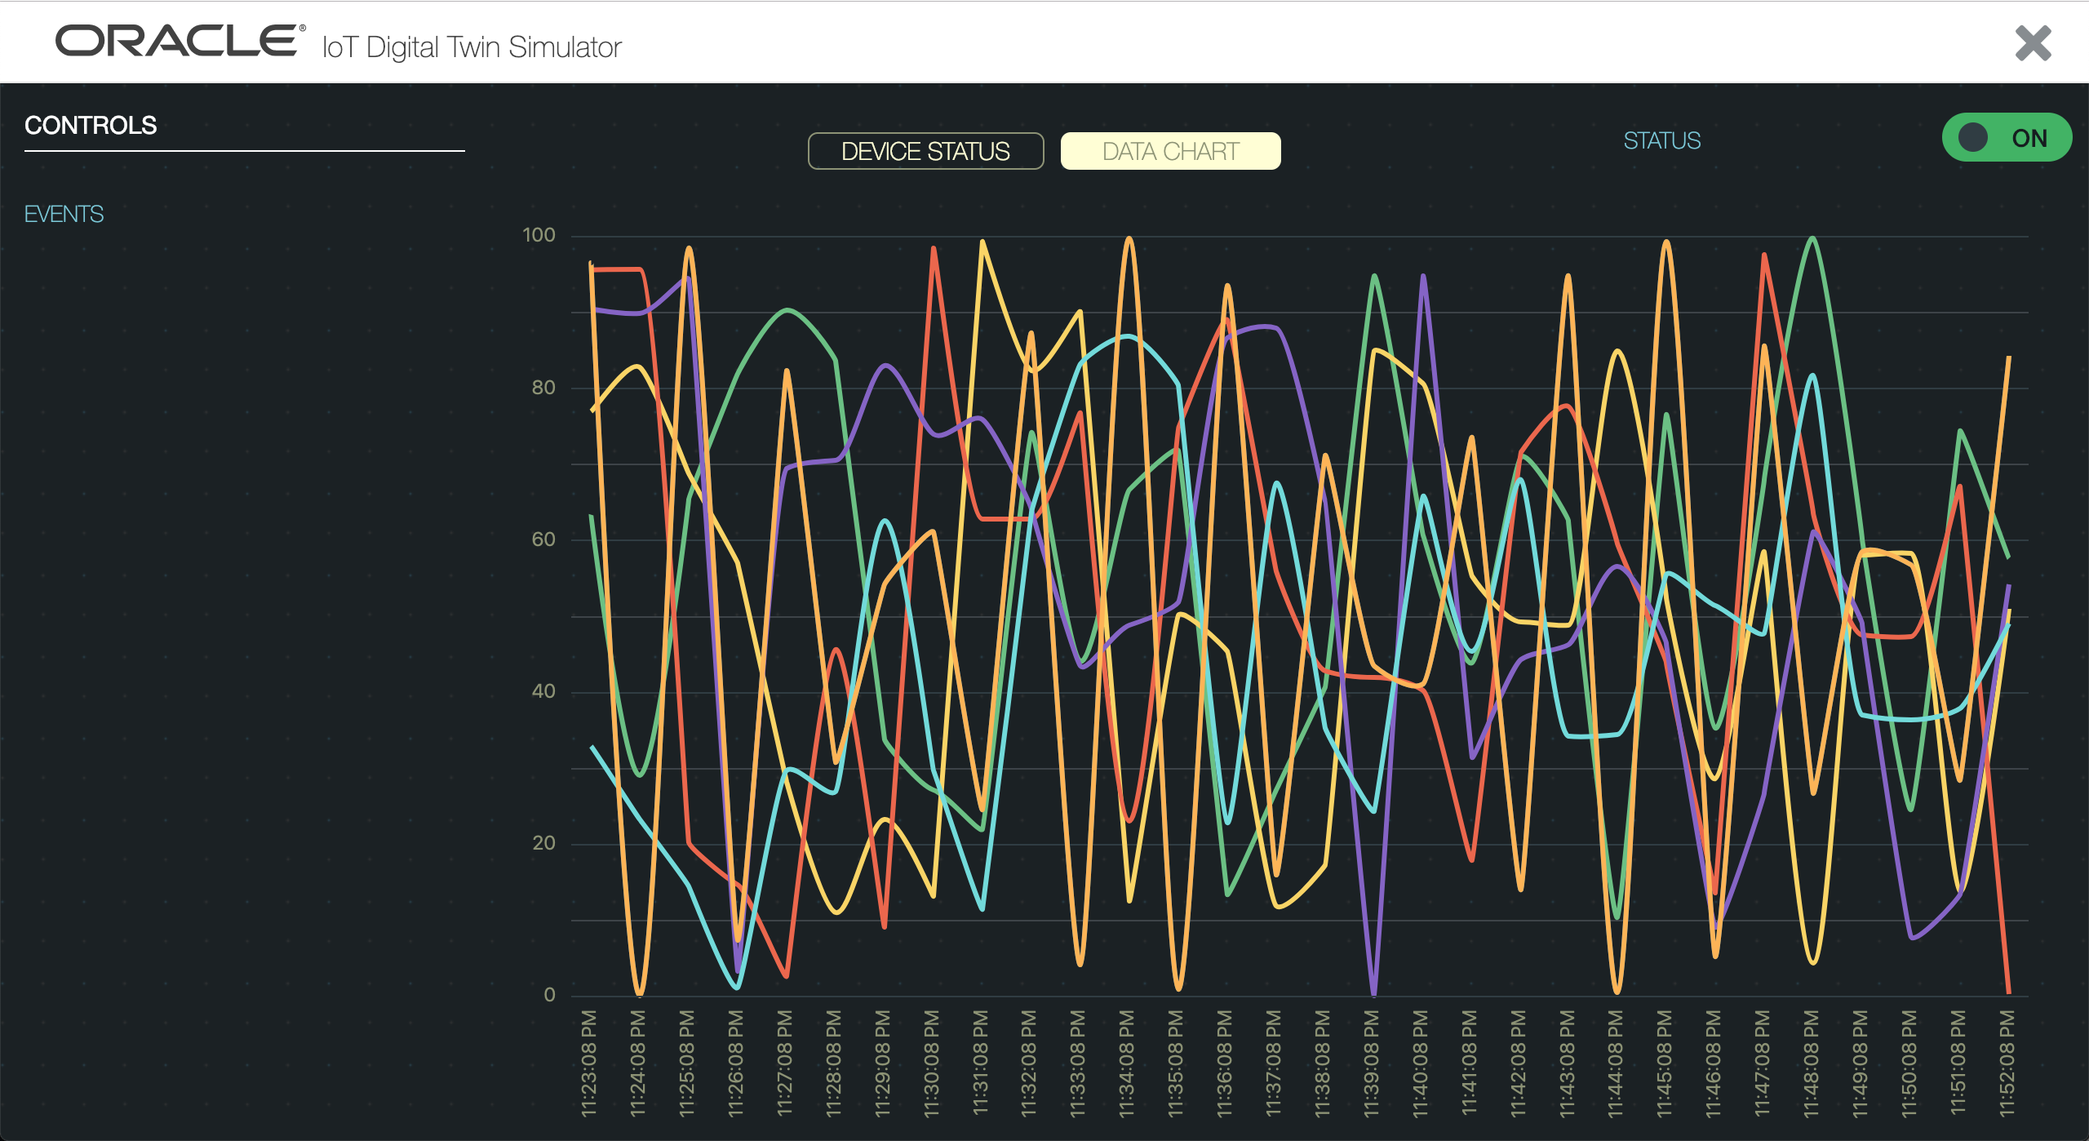
Sensor Simulator (KETI)

Slide 16
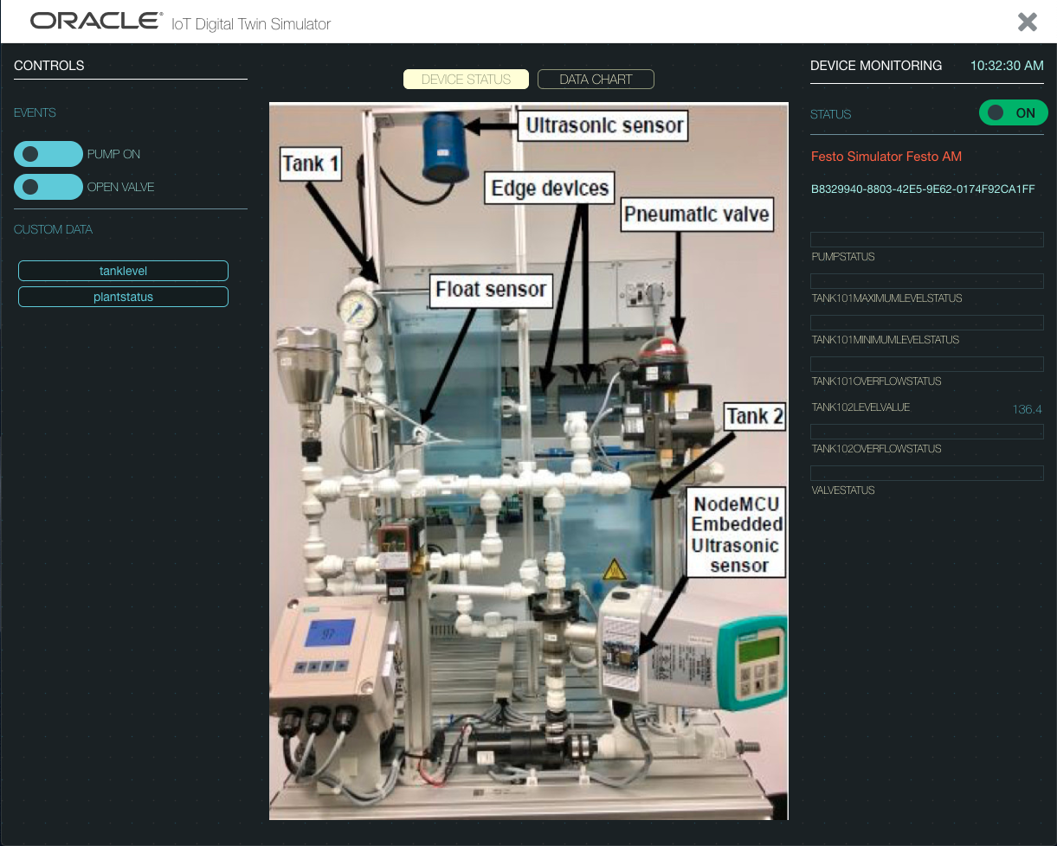
Festo Simulator (Siemens)

Slide 17
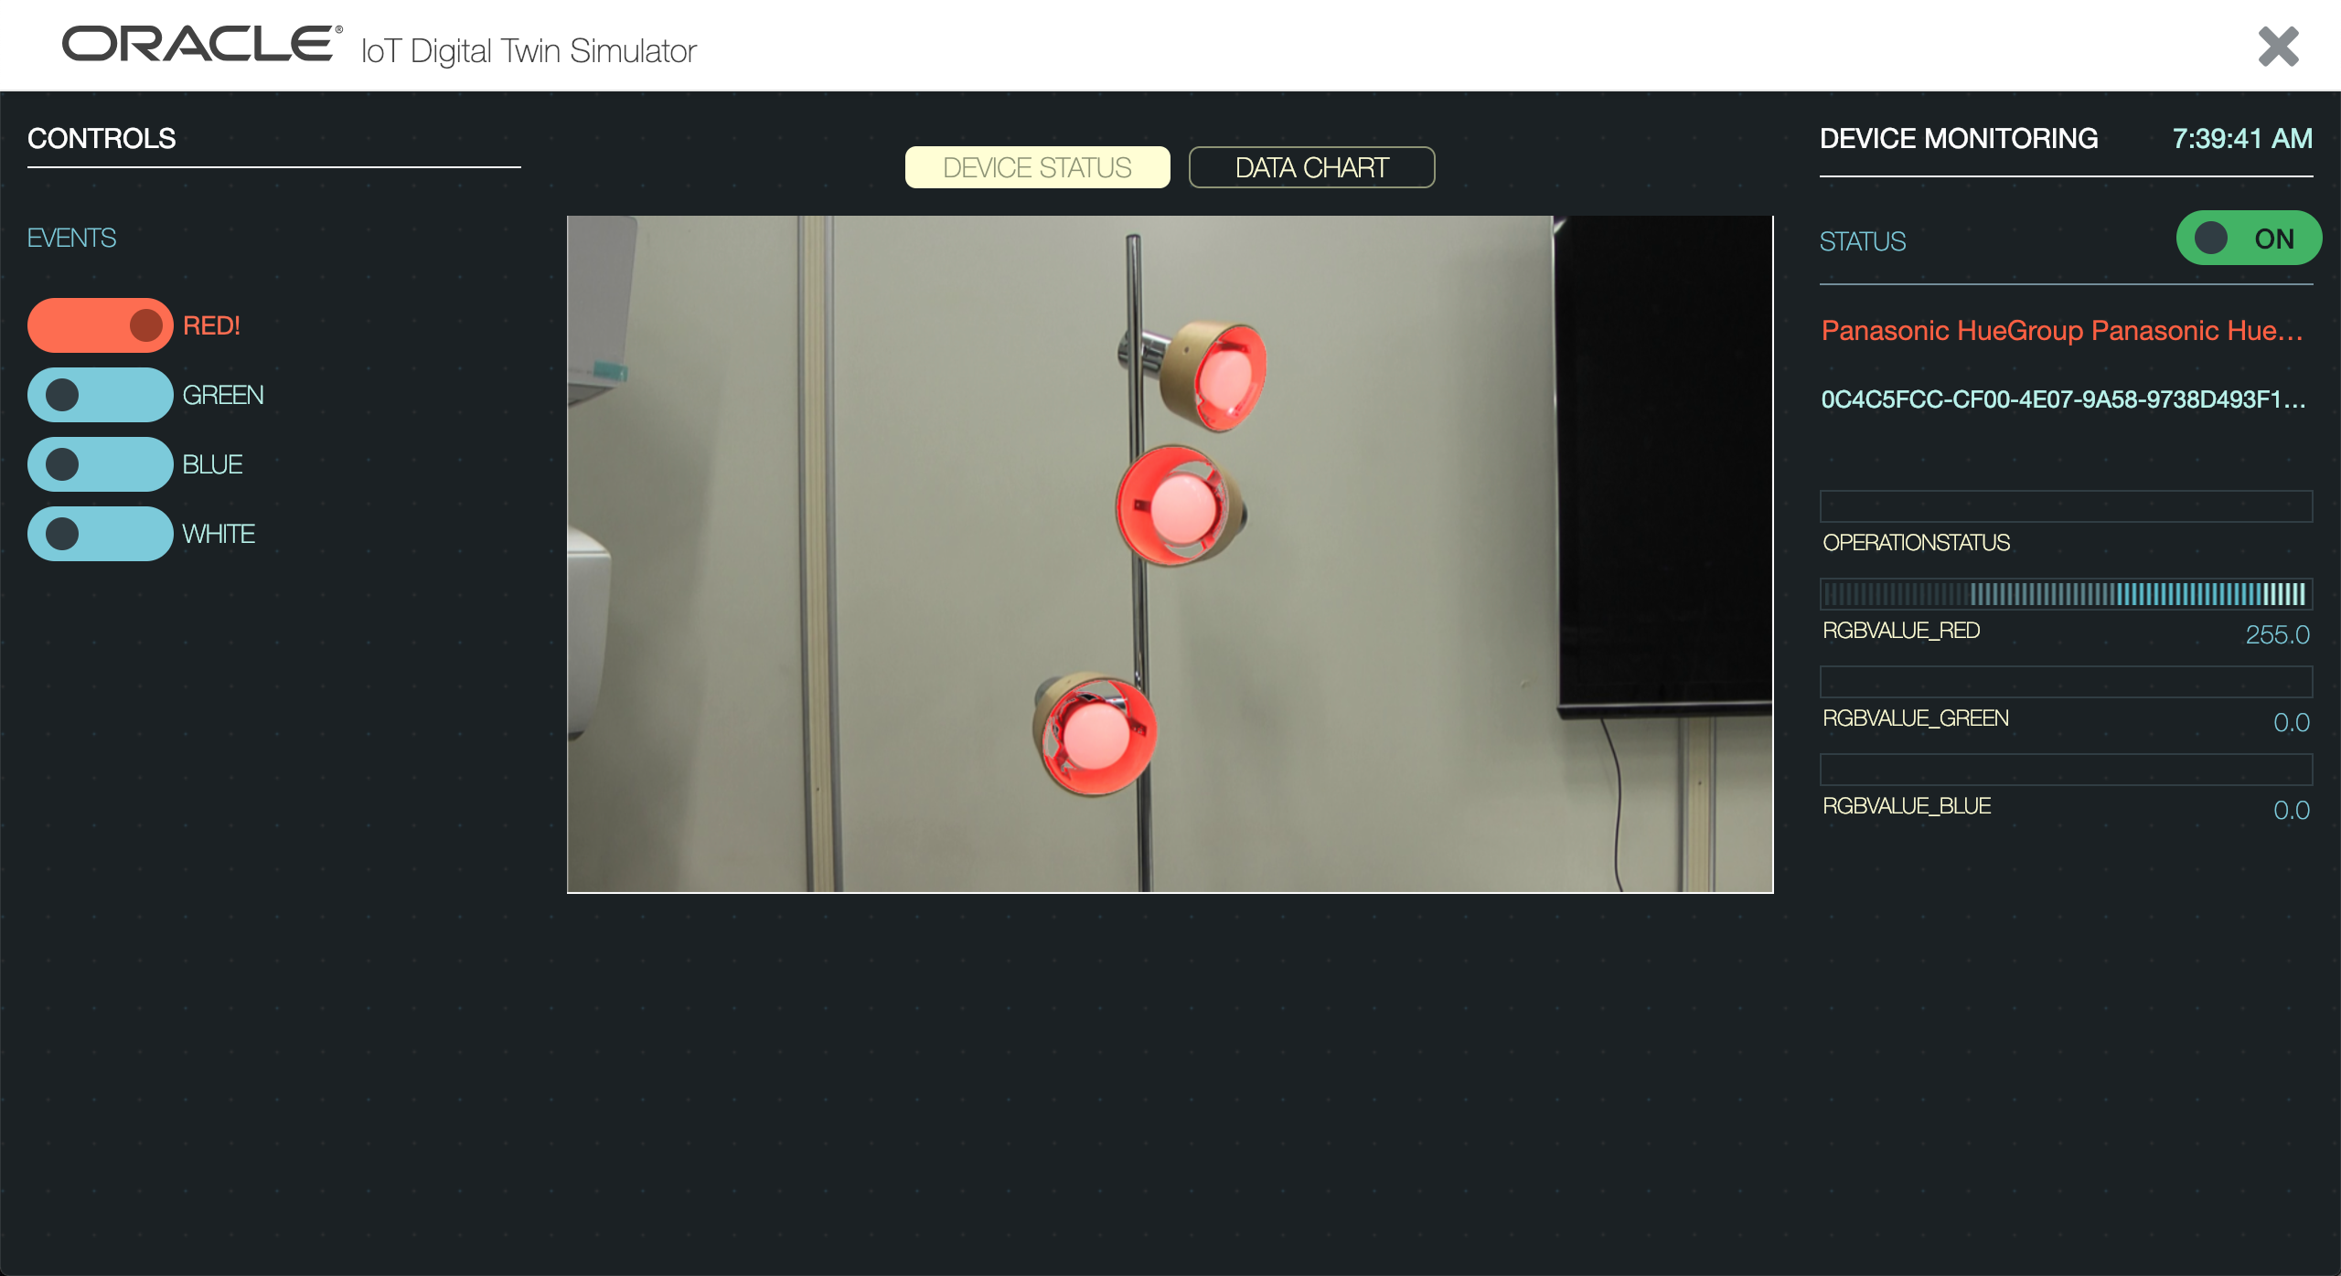
Hue Group Simulator (Panasonic)

Slide 18
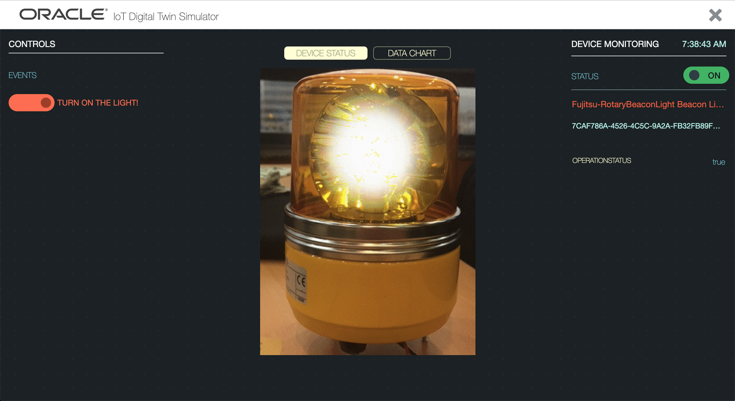
Beacon Light Simulator (Fujitsu)

Slide 19
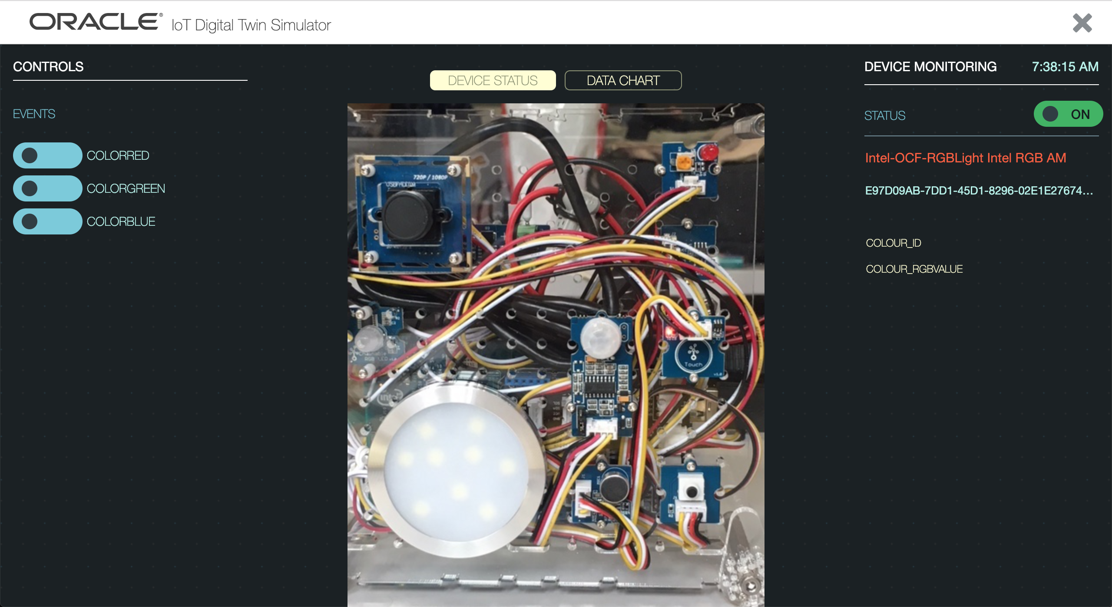
OCF Simulator (Intel)

Slide 20
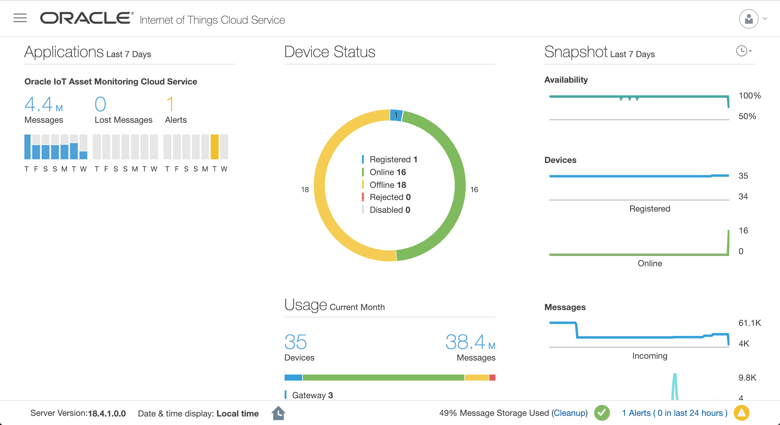
Management Console

Slide 21
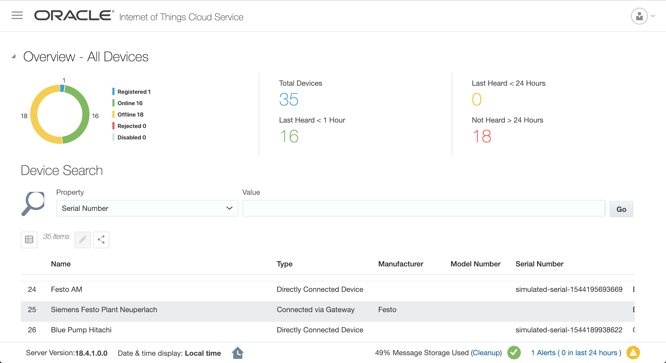
Management console for device management

Slide 22
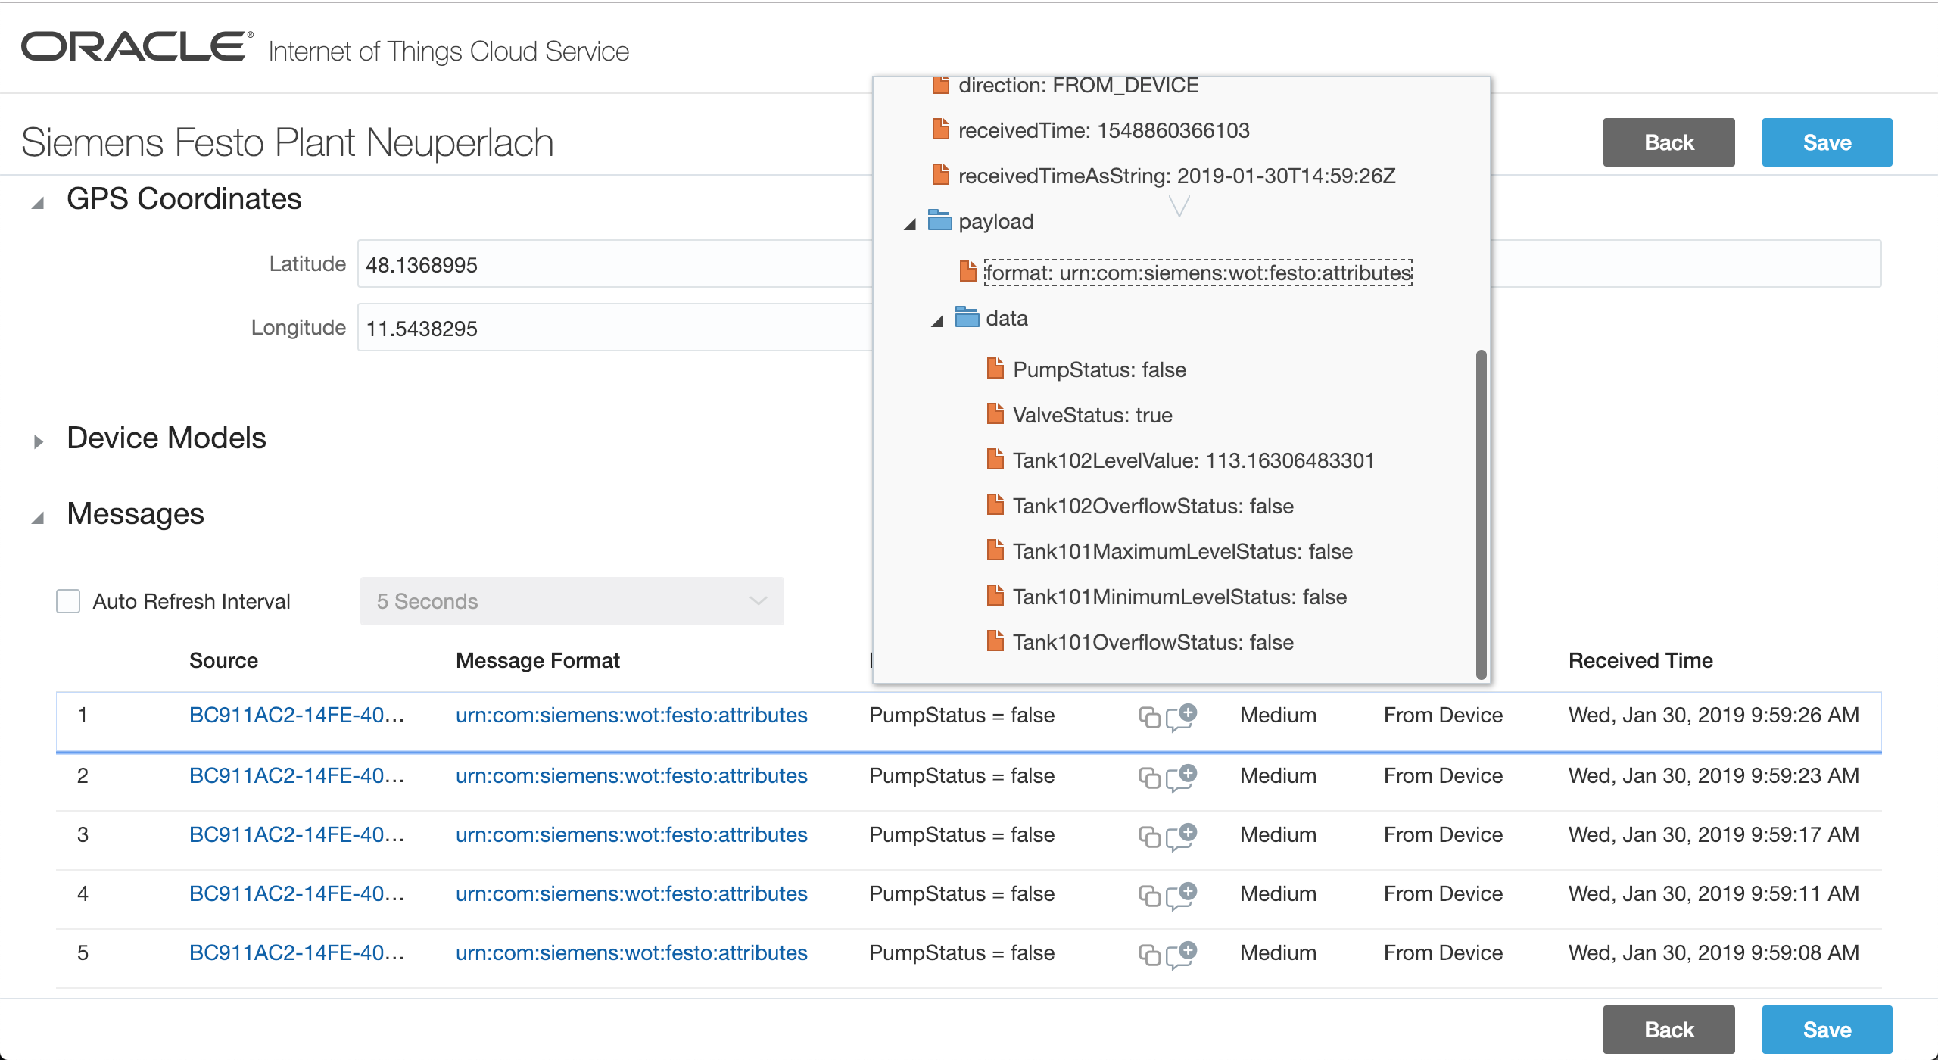
Device Management – Siemens Festo Plant Neuperlach

Slide 23
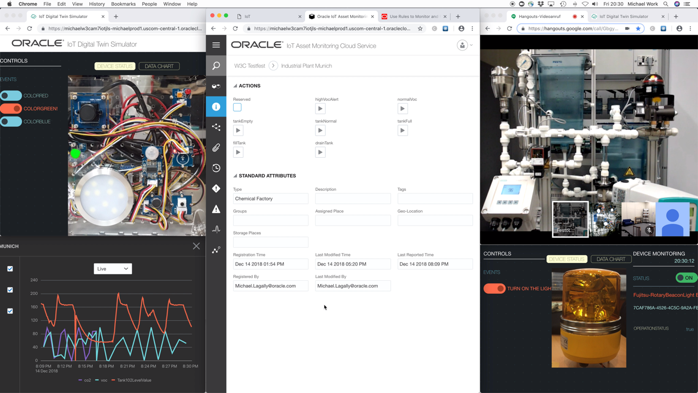
Oracle IoT Asset Monitoring Monitoring and Control of real and simulated devices

Slide 24
WoT Interoperability and Mashup

Slide 25
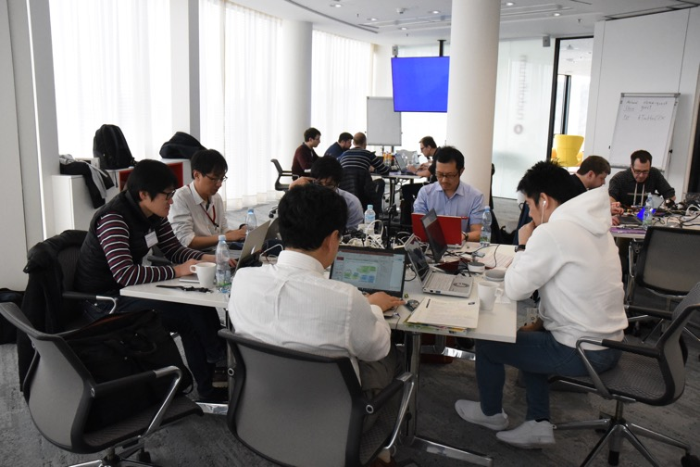
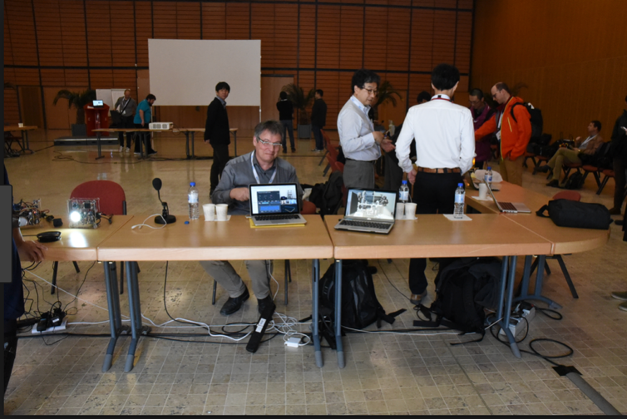
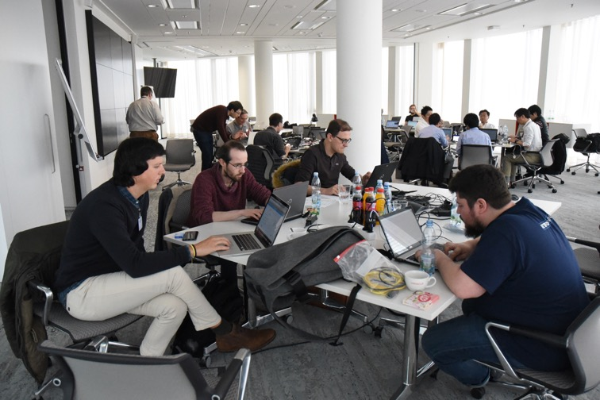
WoT Plugfests
At a plug fest the WoT group members get together to verify the spec with real implementations
PlugFests last for two days on the weekend before the workgroup meeting
See for example https://www.w3.org/2018/03/23-29-wot-minutes.html

Slide 26
Mashup Architecture (TPAC)
NodeRED
(Hitachi)
NodeRED/
Scripting API
(Panasonic)
Node-WoT
application
(Oracle)
Application
(Fujitsu)
mashup.jp
(TUM)
Oracle IF
(td2dm conv.)
Oracle IF
lookup
http://192.168.1.163:8080
TD directory
(Fujitsu)
IoT Cloud Service
(Oracle)
TD directory
(Siemens)
Remote proxy
(Fujitsu)
Long Polling
Oracle IF
TD directory IF (trying)
WebSocket
Oracle IF
http://192.168.1.99:18081
WebSocket (trying)
Oracle-WoT
bridge
(Siemens)
TD directory
(Fujitsu)
Oracle-WoT
bridge
(Fujitsu)
Node-WoT proxy
(Siemens)
Local proxy
(Fujitsu)
Local proxy
(Fujitsu)
WoT-EtherCAT
bridge
(Fujitsu)
Long Polling
Register
Oracle IF
WebSocket
Blind
(Fujitsu)
Sensors
(Fujitsu)
Rotating Light
(Fujitsu)
Device sim.
(Panasonic)
Motion sensor
(Intel)
sensor
(KETI)
IoT Dev. Sim.
(Oracle)
Event Source
(Siemens)
Nabaztag
(Siemens)
Festo Live
(Siemens)
WoT-OCF bridge
(Intel)
Google home
(Panasonic)
HVAC sim.
(Oracle)
Air conditioner
sim.
(Panasonic)
BMW X5
(Eurecom)
Web Camera
(Intel)
OCF devs
(Intel)
LED light
(Panasonic)
Festo sim
(Oracle)
Connected Car sim
(Oracle)
Sensor sim
(KETI)
OCF devs
(Intel)

Slide 27
Oracle IoT Cloud and WoT interoperability
Two interoperability scenarios using Oracle‘s IoT Asset Monitoring were demonstrated at the W3C technical plenary:
A home scenario, where an air conditioner and some lamps were controlled based on sensor data
An industrial scenario, where sensor data controls an industrial plant, an alert light, and gives speech output
Devices are real physical devices connected to the Oracle Cloud:
Siemens: Industrial plant (simulator)
Intel: Speech output and RGB LED lamps
Fujitsu: beacon light
Panasonic: air conditioner and hue lights group, vacuum cleaning robot
Korean Electronics Technology Institute: environment sensor

Slide 28
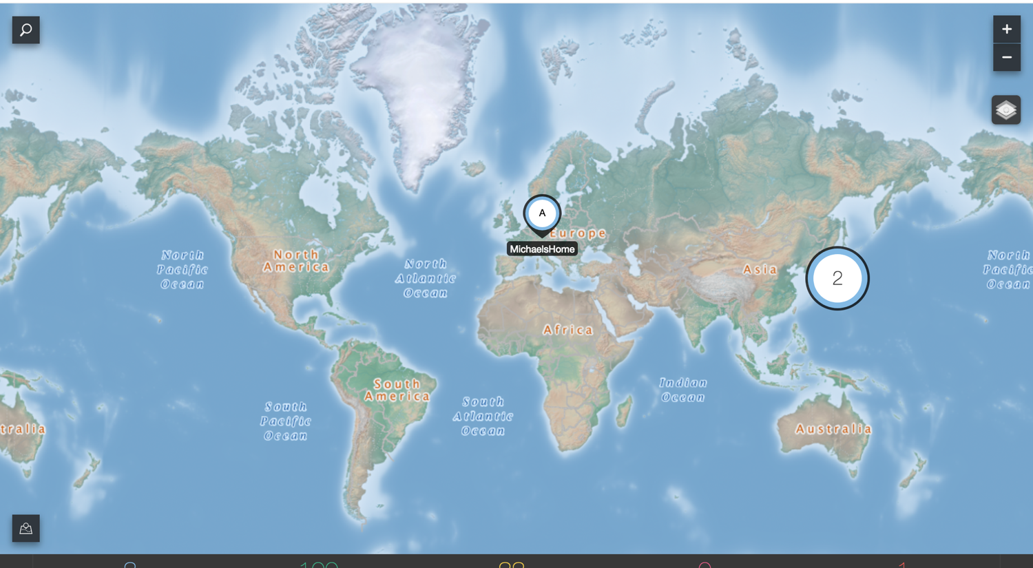
WoT Interoperability Demo Infrastructure
Fujitsu Beacon Light
Intel Webspeak, RGB Light
Hitachi Node-RED
SmartThings Light
France
Siemens FESTO Plant
Germany
KETI Environment Sensor
Korea
Oracle Datacenter
IOT Cloud Service
Asset Monitoring
USA
Panasonic
Smart Home
Fujitsu Smart Home
Japan

Slide 29
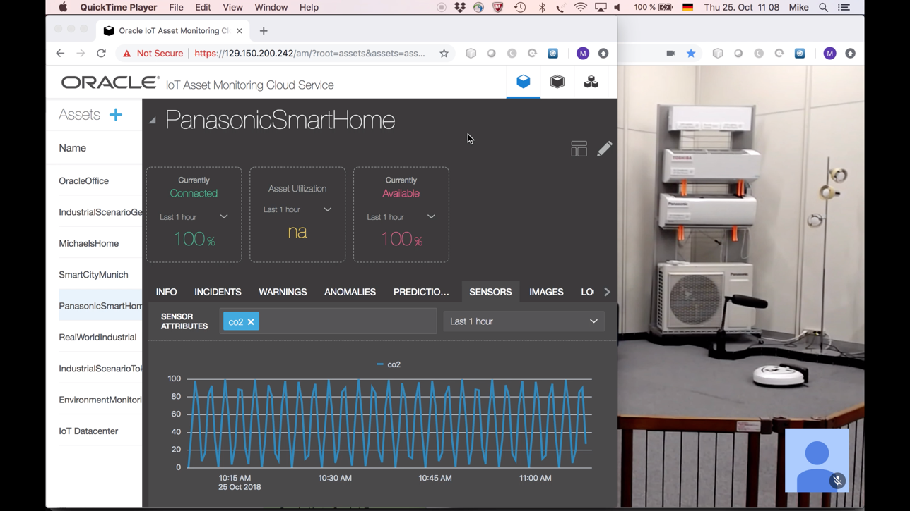
Home Scenario

Slide 30
Industrial Scenario

Slide 31
Q & A For more questions please mail me: Michael.Lagally@oracle.com

